Slide 1
Electric Flux : Mathematica Animation Kirk Boyd

Slide 2
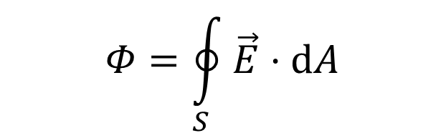
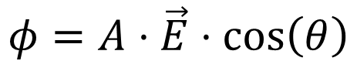
Flux
$$Φ=\oint_{S}{\vec{E}⋅ⅆA}$$
$$φ=A⋅\vec{E}⋅\cos\left(θ\right)$$

Slide 3
Mathematica

Slide 4
Structure
Manipulate[]:
Column[]:
Show[]:
Graphics3D[]:

Slide 5
Changes
Hue[]:
Axes[]:
Thickness[]:

Slide 6
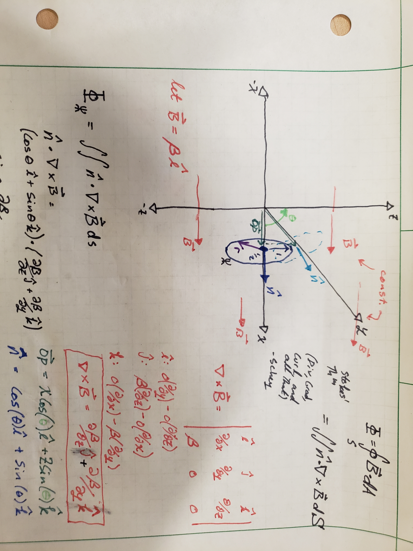
Future Plans

Slide 7
Notebooks

Slide 8
Fin

